Slide 1

Visual Crowd Density Estimation
CNN ve Isı Haritası Regresyonu ile Bir Yaklaşım
Course Name: Computer Vision And Imaging Techniques
Name Surname: Enes Kapsızlar
Date: 27 May 2025

Slide 2
Project Summary and Goals
Problem: Automatically finding and counting people in crowded images.
Main Goal of the Project:
To create a model that can estimate how crowded an area is, using Convolutional Neural Networks (CNNs) and Heatmap Regression.
To check how well the model works using standard methods.
Main Tools Used: Python, PyTorch, OpenCV, Albumentations.
Dataset Used: ShanghaiTech Part A.

Slide 3
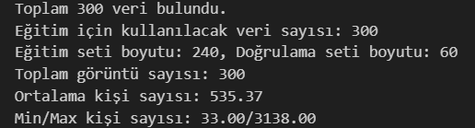
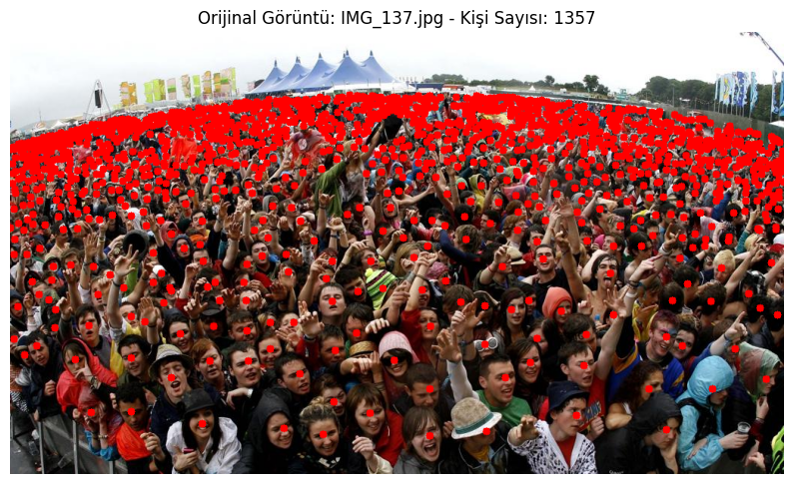
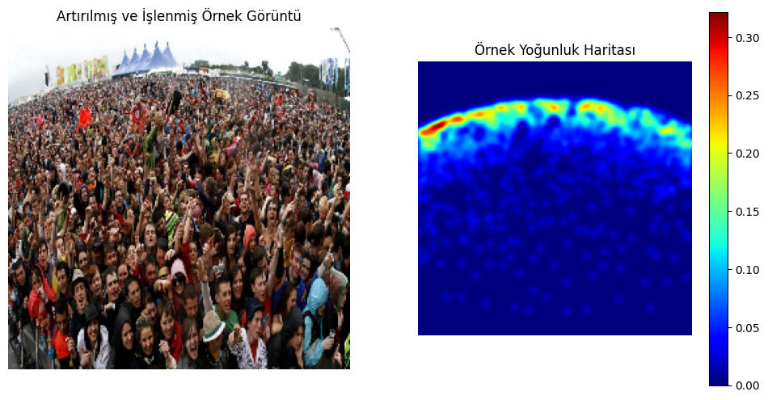
Dataset and Its Features
Dataset Chosen: ShanghaiTech Part A.
Why this dataset?
It's a standard benchmark for crowd counting.
It includes images from challenging and varied scenarios (different densities, views, lighting).
It has detailed annotations (head centers), which are suitable for creating heatmaps.
Usage: 300 training images, 182 test images.

Slide 4
Methodology – Data Preparation Steps
1. Data Preprocessing:
Images were resized (256x256).
Normalization was applied (using ImageNet mean/standard deviation values).
2. Creating Ground Truth:
Density Maps were made from head point annotations using Gaussian kernels.
Sigma Value Used: 3

Slide 5
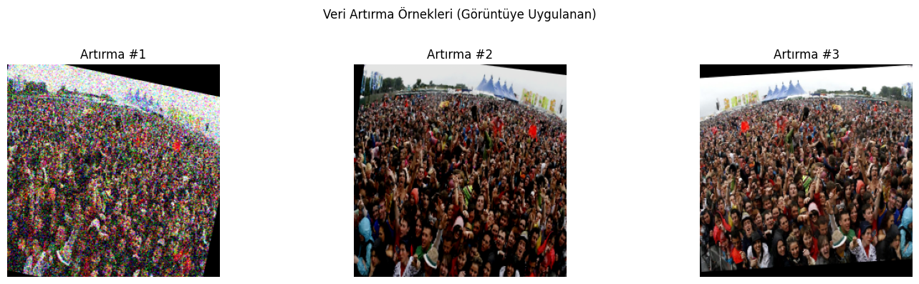
Methodology – Data Augmentation
Goal: To make the model better at working with new, different images and to reduce overfitting (when the model learns the training data too well).
Tool used: Albumentations library.
Main Techniques Applied:
HorizontalFlip
RandomResizedCrop
ColorJitter
RandomBrightnessContrast
GaussNoise
ShiftScaleRotate

Slide 6
Model Used and Our Approach
Model Choice: CrowdCNN. (This is a custom model we built)
Base (Backbone): VGG16 Convolutional Neural Network.
Why VGG16? It's a proven model trained on large datasets like ImageNet, so it's good at feature extraction. By using transfer learning, we used its learned features in our project, aiming for better results with less data.
General Structure: U-Net Like Encoder-Decoder Architecture.
Why U-Net Like? This structure is good at combining general context information (with the encoder) and precise location information (with the decoder and skip connections). It's suitable for tasks that predict on a pixel-by-pixel basis, like density maps.
Model's Goal: To create a Density Map (heatmap) from an input image, where each pixel shows how crowded that spot is.

Slide 7
Methodology – Training Details
Loss Function: combined_loss
Part 1: Pixel-wise Mean Squared Error (MSELoss) -> For map accuracy.
Part 2: Weighted Relative Count Error (Sum Loss) -> For total count accuracy.
Weight Parameter (sum_loss_weight): 15.0
Optimizer: AdamW (learning_rate): 3e-05
Learning Rate Scheduler: ReduceLROnPlateau (based on Validation MAE).
Training Duration: 50 Epoch, Batch Size: 4.
Strategy: Saved the model weights that gave the best validation MAE (like Early Stopping).

Slide 8
Evaluation Metrics
Main Metrics Used:
Mean Absolute Error (MAE): The average absolute difference between the predicted and real number of people. |Real - Predicted|
Root Mean Squared Error (RMSE): More sensitive to large errors. sqrt(average((Real - Predicted)^2))
Why MAE and RMSE?
Our project is a regression problem (predicting a continuous number of people).
MAE and RMSE are standard and suitable metrics for regression tasks like this, showing how accurate our model's count is.
Why Not Other Metrics (Accuracy, Precision, Recall,F1):
These metrics are designed for classification problems.
They are not directly useful for our task of density estimation and counting people.

Slide 9
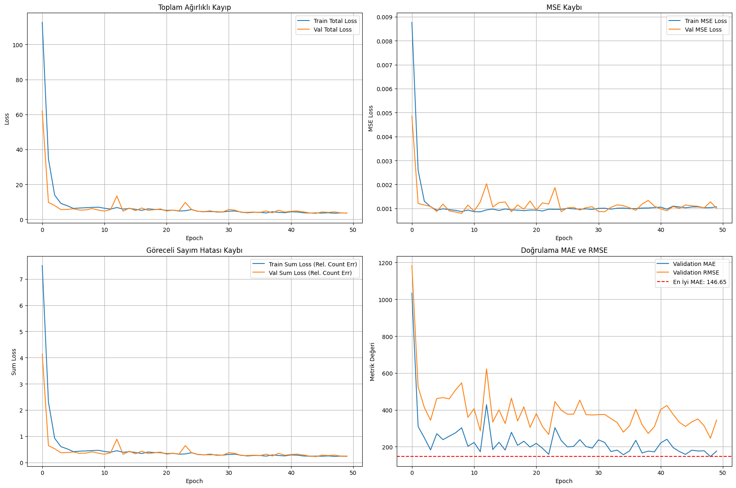
Results – Training Performance
Learning Status: The model showed learning throughout the training process.
Overfitting: Towards the end of the training, there was a slight increase in the validation loss; this might suggest the model was starting to overfit a little. This was managed by the early stopping feature (saving the best model).
Performance Metrics: Validation MAE and RMSE values decreased as training progressed.
Best Result: The best validation MAE was 146.65.

Slide 10
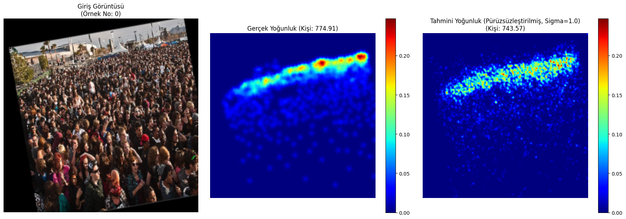
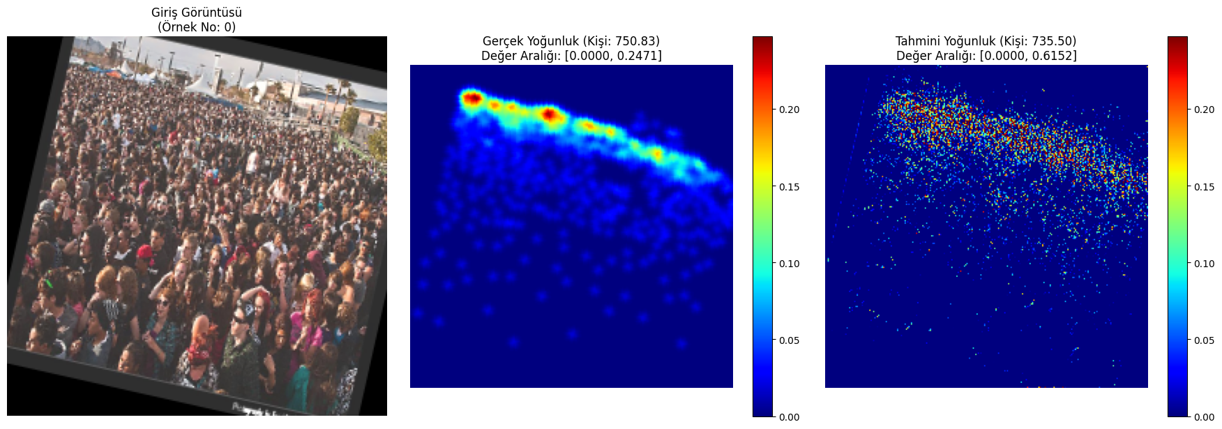
Results – Numerical Success and Visual Examples
Best Model's Performance (ShanghaiTech Part A Test/Validation Set):
MAE: 146.65
RMSE: 257.25
The MAE of 146.65 shows that, on average, the model's predicted count was off by about 147 people from the actual count.
The RMSE value 257.25 being higher than MAE suggests that the model sometimes made larger errors on certain examples. This can be expected, especially in very crowded or difficult scenes.
Overall, the model showed a promising basic performance for crowd counting on the challenging ShanghaiTech Part A dataset.

Slide 11
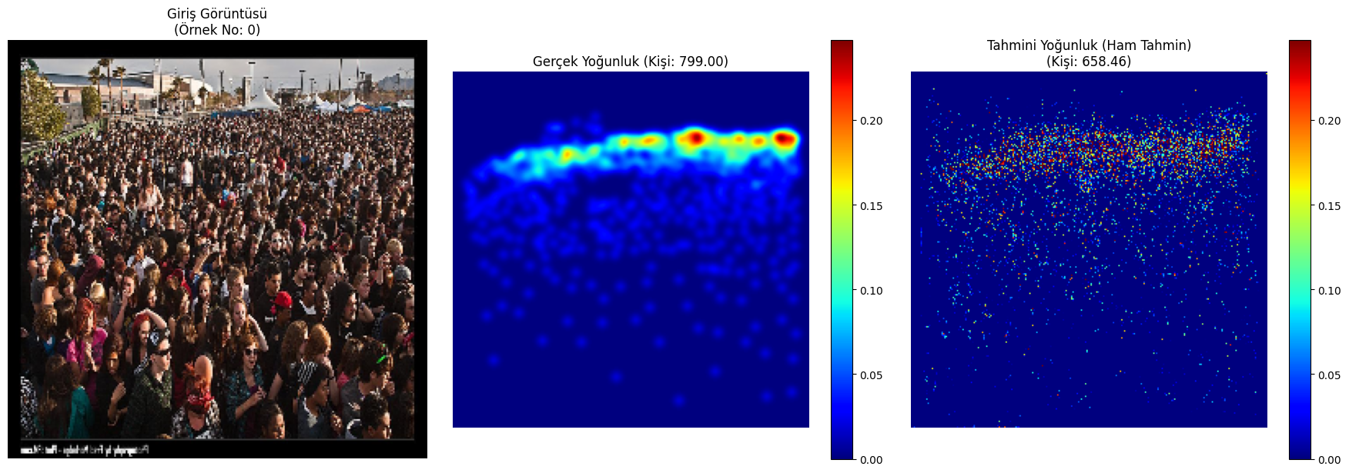
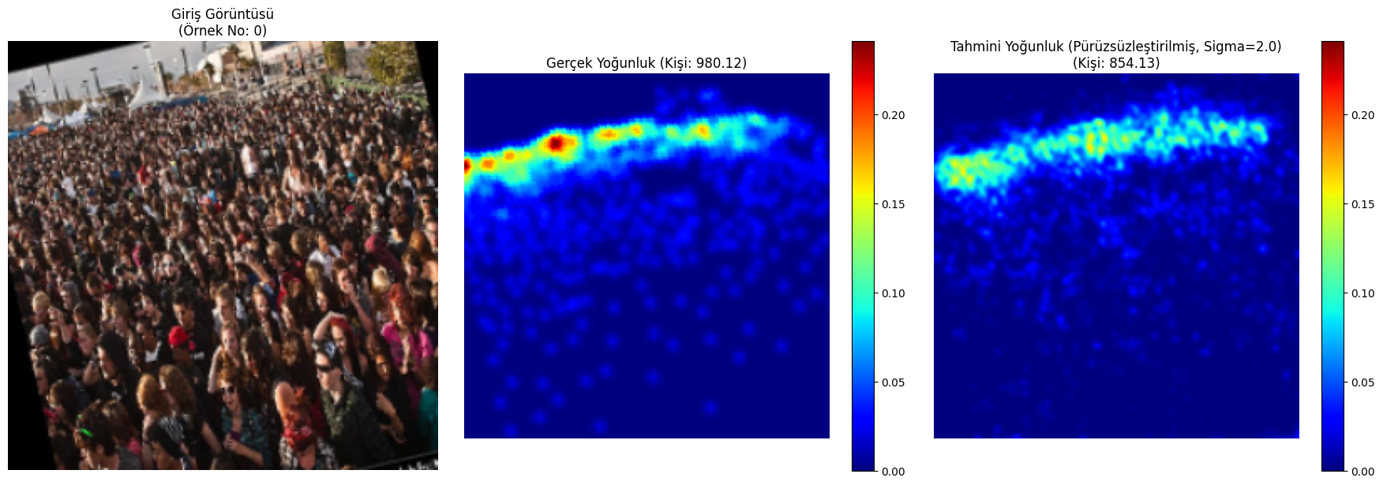
Results – Challenging Cases and Smoothing Effect
Challenging Example:
The model can find it hard to accurately count people in scenes with very high density and where people overlap a lot, like in this example.
Although the predicted density map generally shows the crowd's distribution, it underestimated the count compared to the real number. This might be because it's difficult to tell individual people apart in very crowded areas.
Smoothing Analysis:
Using a Gaussian filter to improve the visual quality of raw predictions.
The model's raw (basic) density map predictions can be made visually better by smoothing them with a Gaussian filter.
Different sigma values affect the predicted number of people. In this example, small sigma values (like 0.5, 1.0) made the predicted count closer to the real count, while higher sigma values could give different results.
The best sigma value can change depending on the dataset and how the model's output looks; this is a parameter that can be adjusted as a final (post-processing) step.

Slide 12
Meeting Project Requirements
Dataset Selection and Analysis: ShanghaiTech Part A was used, and its features were analyzed.
Data Preprocessing: Image resizing, normalization, and density map creation were done.
Data Augmentation: Various techniques were applied using Albumentations, and examples were visualized.
Model Training and Evaluation: A VGG16-based CNN was trained, and validation was done using MAE/RMSE metrics.
Jupyter Notebook: All steps were presented in the notebook with code, Markdown explanations, and visualizations.

Slide 13
Project Review
Main Findings and Achievements:
Successfully applied the method of crowd density estimation using CNNs and heatmap regression.
Most Important Achievement: We successfully used transfer learning (VGG16) and a U-Net like model with heatmap regression to get meaningful results (MAE: 146.65) for crowd density estimation on the challenging ShanghaiTech Part A dataset.
Most Important Thing Learned: We gained practical experience in completing an end-to-end deep learning project. This included preparing data, data augmentation, choosing a suitable loss function, and evaluating the model, and we saw how these parts affect the model's performance.
Challenges and Limitations Faced:
Making the model work well in different scenarios (generalization).
Accuracy in very crowded situations.
Potential Improvements:
Trying more advanced/specialized CNN models.
Training with more varied datasets.
Integrating video analysis.

Slide 14
Closing
Summary: In this project, we successfully developed and tested a system for visual crowd density estimation using a VGG16-based CNN and heatmap regression. We got promising results on the ShanghaiTech dataset. This project was an important step in understanding the basics and practical uses of this topic.

